Slide 1
Apples issues and successful strategy

Slide 2
Apple Issues or Unexploited Opportunities includes
1. New product introductions – continue investment in R&D
2. Protecting Intellectual Property
3. Supplier agreements and move production back to US with automation to reduce costs

Slide 3
Apple’s Strategy leads to Profitability
What makes a competitive advantage “ sustainable “ ( or durable) opposed to temporary, are elements of a strategy that gives buyers lasting reasons to prefer a company’s products or services over those of competitors—reasons that competitors are unable to nullify, duplicate, or overcome despite best efforts.

Slide 4
What are Elements of a Strategy?
Activities
Strategy is about performing different activities from rivals’ or performing similar activities in different ways not better ways. If you only perform activities better than others will soon adapt and adopt to your activities and either match or surpass you. You will in turn adapt and adopt and the cycle will continue without any clear winner. Strategy is a coordinated set of activities ( actions) that managers take in order to outperform competition and achieve superior profitability that is sustainable.

Slide 5
And makes it difficult for competitors to weaken or overcome Apple’s CA.

Slide 6
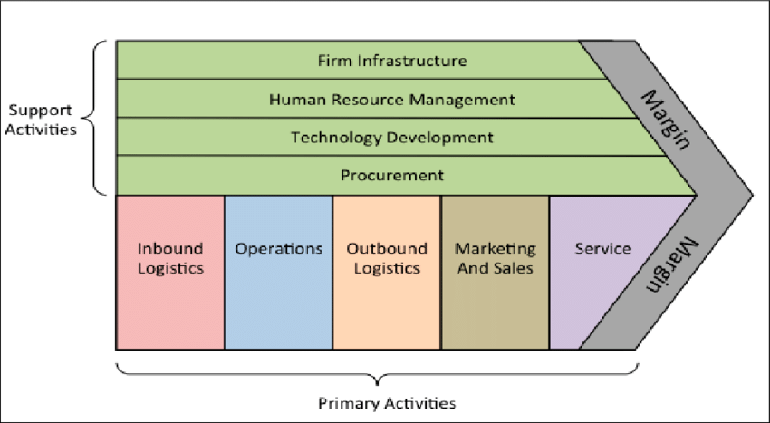
Elements of a company’s strategy is found in the actions of the company’s value chain

Slide 7
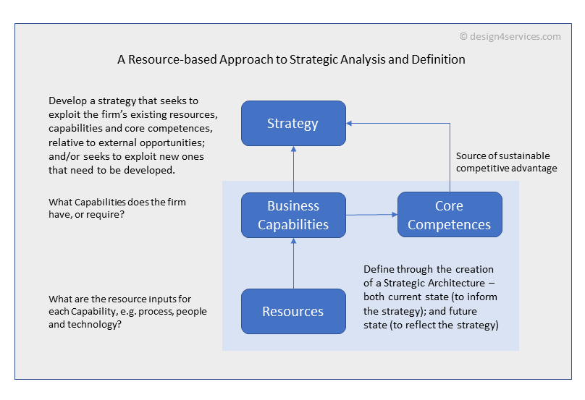
Elements are supported by the company’s resources, capabilities, and core competences

